Slide 1
Predictive Modeling
Chapter 13: Nonlinear Classification Models
STA 6543
The University of Texas at San Antonio

Slide 2
Overview
Part I: General Strategies
Part II: Regression Models
Chapter 6: Linear Regression and Its Cousins
Chapter 7: Nonlinear Regression Models
Chapter 8: Regression Trees and Rule-Based Models
Part III: Classification Models
Chapter 11: Measuring Performance in Classification Models
Chapter 12: Discriminant Analysis and Other Linear Classification Models
Chapter 13: Nonlinear Classification Models
Chapter 14: Classification Trees and Rule-Based Models

Slide 3
Nonlinear Classification Models
In Chapter 12, we discussed the models that were intrinsically linear — the structure of the model would produce linear class boundaries unless nonlinear functions of the predictors were manually specified.
In this chapter, we deal with some intrinsically nonlinear models
Nonlinear discriminant analysis
quadratic discriminant analysis (QDA)
regularized discriminant analysis (RDA)
mixture discriminant analysis (MDA).
Naïve Bayes
K-nearest neighbors
Neural networks
Flexible discriminant analysis
Support vector machines
R demonstrations for the stock market data

Slide 4
Nonlinear discriminant analysis
Chapter 13: Nonlinear Classification Models

Slide 5
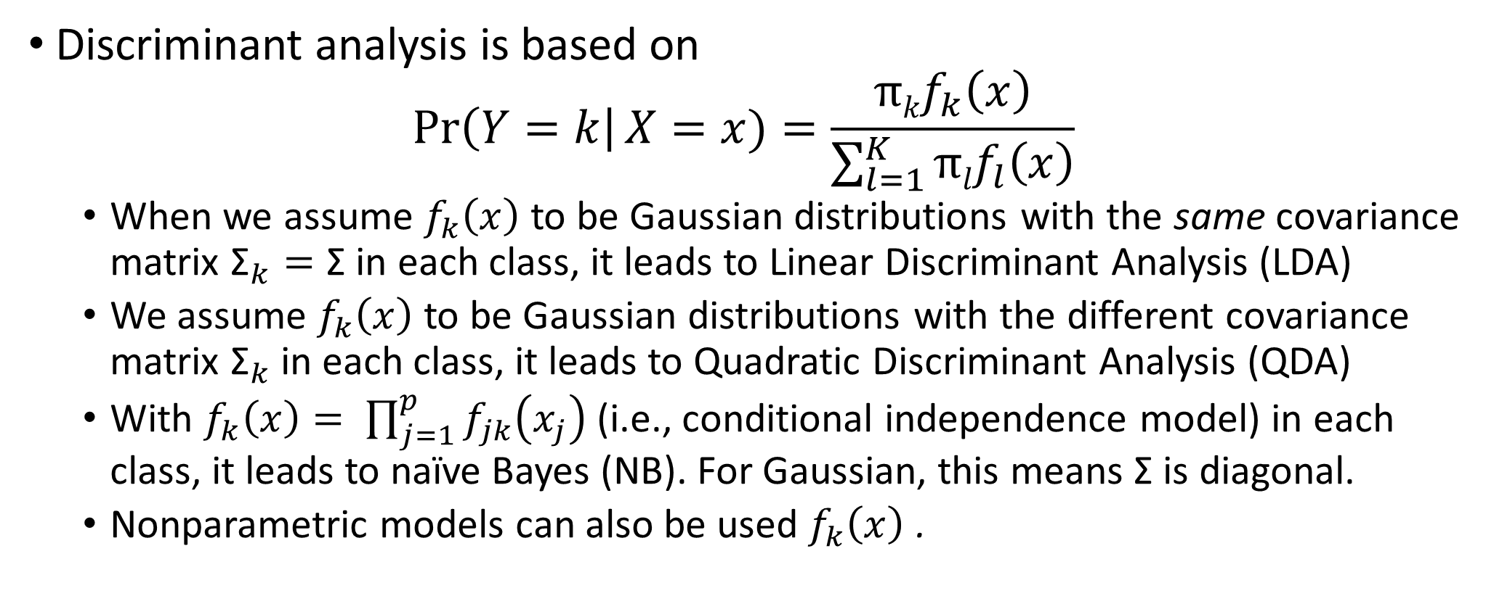
A general form of discriminant analysis
Discriminant analysis is based on
$$\operatorname{Pr}\left(Y=k\right|X=x)=\frac{{πkf}_{k}\left(x\right)}{\sum_{l=1}^{K}{{πlf}_{l}\left(x\right)}}$$
When we assume $f_{k}\left(x\right)$ to be Gaussian distributions with the same covariance matrix ${\text{Σ}}_{k}=\text{Σ} \text{in}$each class, it leads to Linear Discriminant Analysis (LDA)
We assume $f_{k}\left(x\right)$ to be Gaussian distributions with the different covariance matrix ${\text{Σ}}_{k}$in each class, it leads to Quadratic Discriminant Analysis (QDA)
With $f_{k}\left(x\right)= \prod_{j=1}^{p}{f_{jk}\left(x_{j}\right)}$ (i.e., conditional independence model) in each class, it leads to naïve Bayes (NB). For Gaussian, this means Σ is diagonal.
Nonparametric models can also be used $f_{k}\left(x\right)$ .

Slide 6
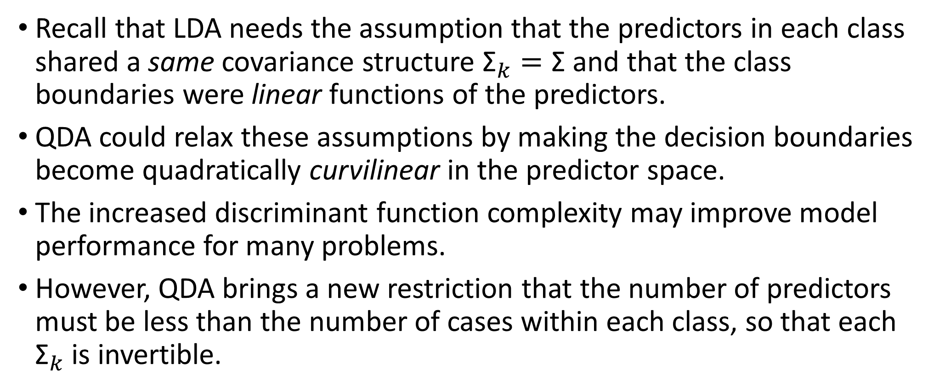
LDA, QDA, and RDA
Recall that LDA needs the assumption that the predictors in each class shared a same covariance structure ${\text{Σ}}_{k}=\text{Σ}$and that the class boundaries were linear functions of the predictors.
QDA could relax these assumptions by making the decision boundaries become quadratically curvilinear in the predictor space.
The increased discriminant function complexity may improve model performance for many problems.
However, QDA brings a new restriction that the number of predictors must be less than the number of cases within each class, so that each ${\text{Σ}}_{k}$ is invertible.

Slide 7
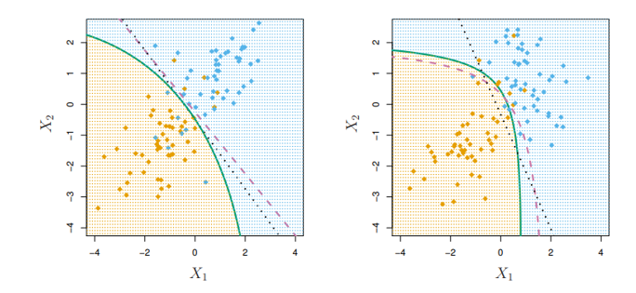
LDA vs. QDA
If the decision boundary (purple dashed) is linear, it is more accurately approximated by LDA (black dotted) than by QDA (green solid).
If the decision boundary (purple dashed) is nonlinear, it is more accurately approximated by QDA (green solid) than by LDA (black dotted).

Slide 8
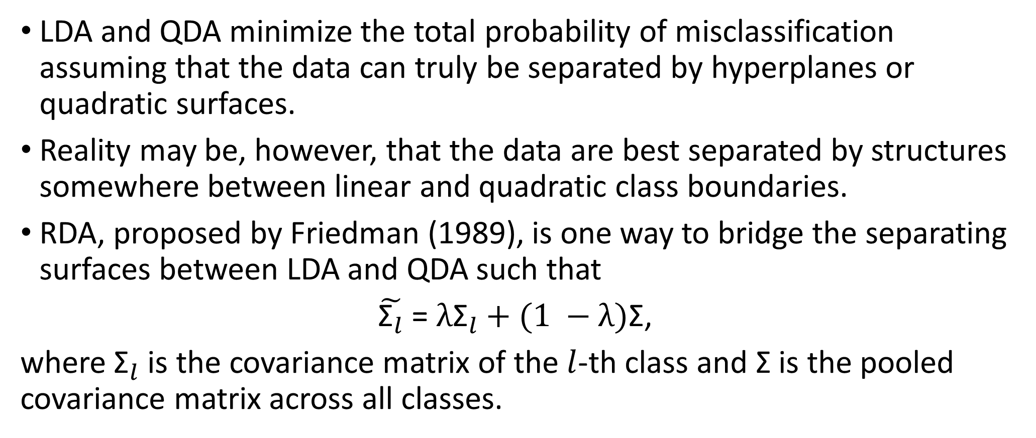
LDA, QDA, and RDA
LDA and QDA minimize the total probability of misclassification assuming that the data can truly be separated by hyperplanes or quadratic surfaces.
Reality may be, however, that the data are best separated by structures somewhere between linear and quadratic class boundaries.
RDA, proposed by Friedman (1989), is one way to bridge the separating surfaces between LDA and QDA such that
$\tilde{{\text{Σ}}_{l}}$ = $λ{\text{Σ}}_{l}+(1 −λ)\text{Σ}\text{,}$
where ${\text{Σ}}_{l}$is the covariance matrix of the $l$-th class and Σ is the pooled covariance matrix across all classes.

Slide 9
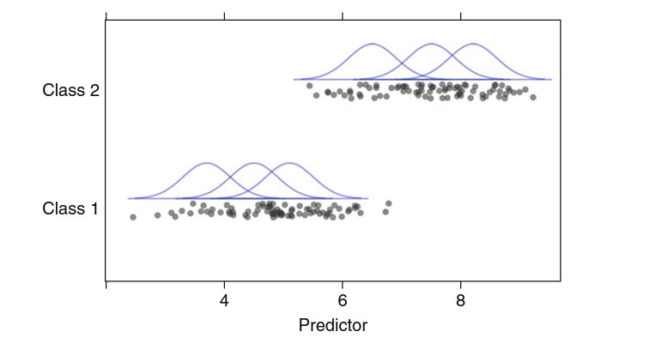
Mixture discriminant analysis (MDA)
MDA is as an extension of LDA by allowing each class to be represented by multiple multivariate normal distributions.

Slide 10
Mixture discriminant analysis (MDA)
These distributions can have different means but, like LDA, the covariance structures are assumed to be the same.
We would specify how many different distributions should be used and the MDA model would determine their optimal locations in the predictor space.
The number of distributions per class is the tuning parameter for the model (they need not be equal per class).
Also, similar to LDA, using ridge- and lasso-like penalties to MDA would integrate feature selection into the MDA model.

Slide 11
The stock market data
# required packages library(AppliedPredictiveModeling) library(caret) library(ISLR) #the stock market data library(pROC) #roc library(MASS) #lda library(klaR) #rda library(mda) #mda library(earth) #fda library(e1071) library(kernlab) #SVM ###Data splitting train = which(Year<2005) Smarket.train= Smarket[train,]; # observations before 2005 are served as test data. Smarket.test= Smarket[-train,]; # observations from 2005 are served as test data.

Slide 12
Train control function
### Create a control function that will be used across models. set.seed(100) ctrl <- trainControl(method = "LGOCV", summaryFunction = twoClassSummary, classProbs = TRUE, savePredictions = TRUE) # LGOCV: Repeated Train/Test Splits Estimated (25 reps, 75%)

Slide 13
QDA
set.seed(476) QDATune <- train(x = as.matrix(Smarket.train[,1:8]), y = Smarket.train$Direction, method = "qda", metric = "ROC", trControl = ctrl) QDATune #library(pROC) ### Predict the test set based the logistic regression Smarket.test$QDA <- predict(QDATune,Smarket.test, type = "prob")[,1] #ROC for QDA model QDAROC <- roc(Smarket.test$Direction, Smarket.test$QDA) plot(QDAROC, col=1, lty=1, lwd=2) #Confusion matrix of QDA model confusionMatrix(data = predict(QDATune, Smarket.test), reference = Smarket.test$Direction)

Slide 14
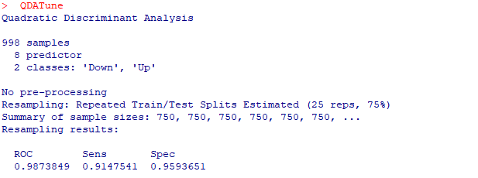
QDA output

Slide 15
ROC from QDA

Slide 16
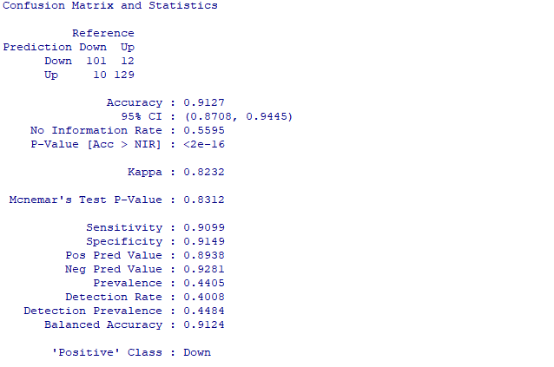
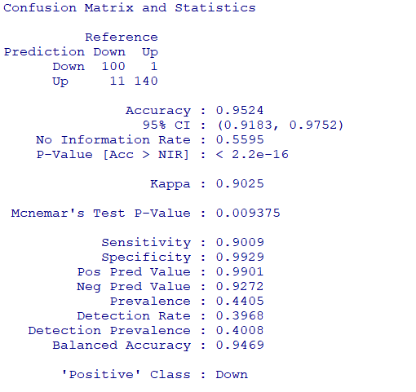
Confusion matrix from QDA

Slide 17
RDA
######################regularized discriminant analysis####################### set.seed(476) RDATune <- train(x = as.matrix(Smarket.train[,1:8]), y = Smarket.train$Direction, method = "rda", preProc = c('center', 'scale'), metric = "ROC", trControl = ctrl) RDATune

Slide 18
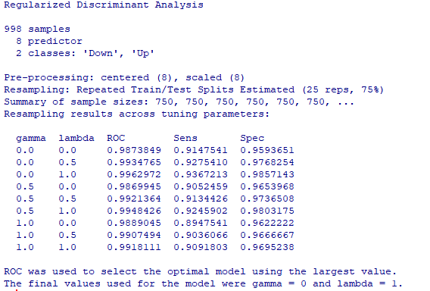
RDA output

Slide 19
MDA
###################################mixture discriminant analysis####################### set.seed(476) MDATune <- train(as.matrix(Smarket.train[,1:8]), y = Smarket.train$Direction, method = "mda", tuneGrid = expand.grid(.subclasses = 3:10), metric = "ROC", trControl = ctrl) MDATune

Slide 20
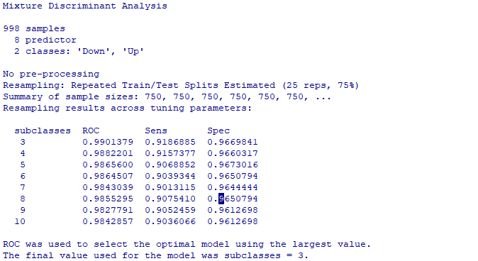
MDA output

Slide 21
Naïve Bayes and KNN
Chapter 13: Nonlinear Classification Models

Slide 22
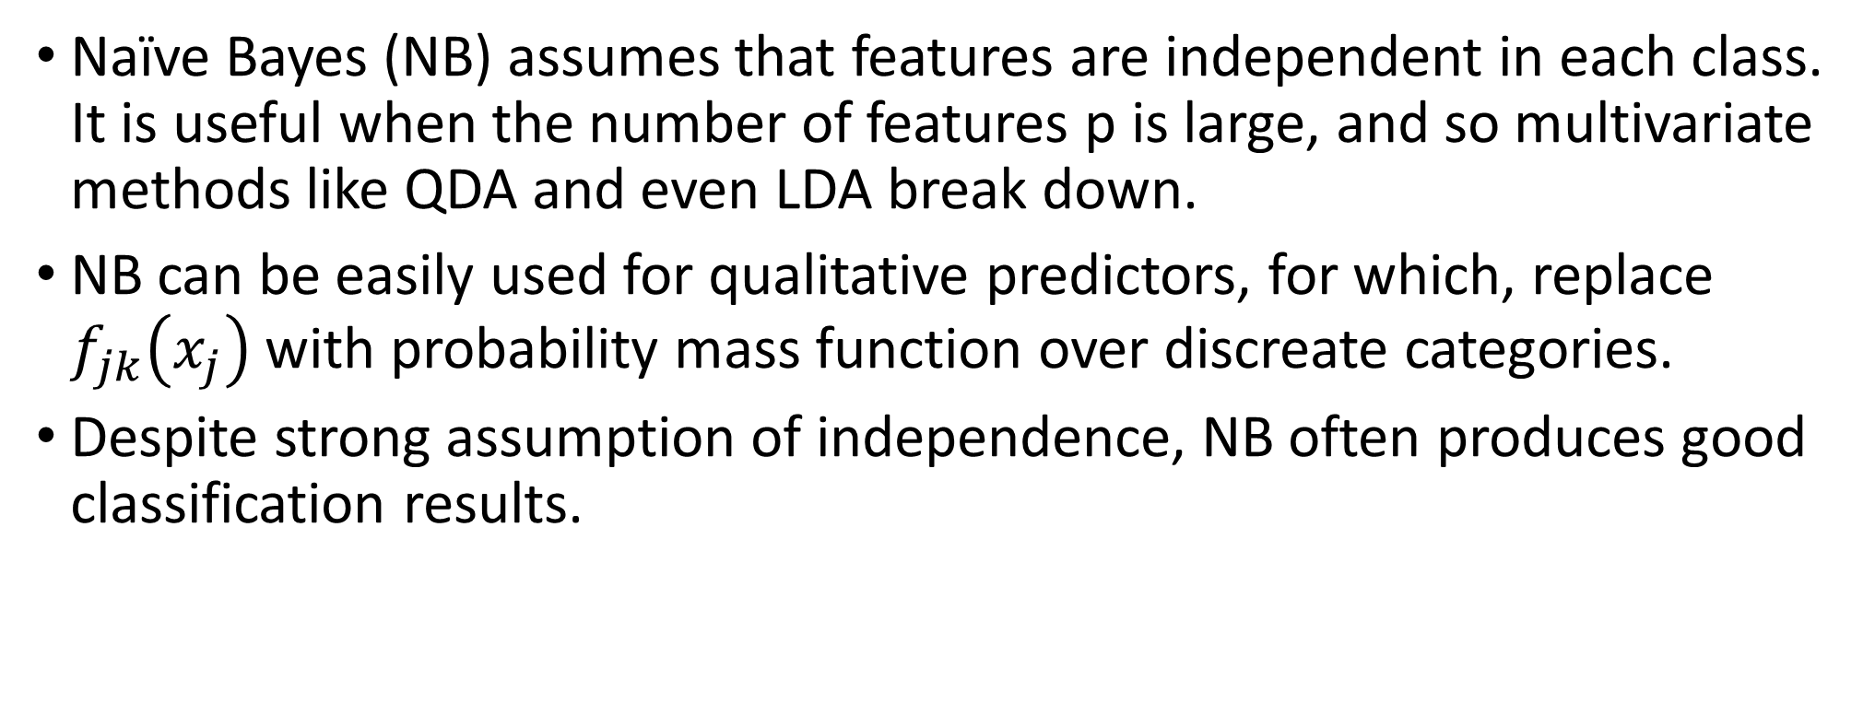
Naïve Bayes
Naïve Bayes (NB) assumes that features are independent in each class. It is useful when the number of features p is large, and so multivariate methods like QDA and even LDA break down.
NB can be easily used for qualitative predictors, for which, replace $f_{jk}\left(x_{j}\right)$ with probability mass function over discreate categories.
Despite strong assumption of independence, NB often produces good classification results.

Slide 23
Logistic regression vs. LDA
Similarity: Both logistic regression and LDA produce linear boundaries.
Difference lies in fitting procedures
LDA assumes that the observations are drawn from the Gaussian distribution with a same variance in each class, while logistic regression does not have this assumption.
LDA would do better than logistic regression if the assumption of normality hold, otherwise, logistic regression could outperform LDA.

Slide 24
Logistic regression vs. LDA
Similarity: Both logistic regression and LDA produce linear boundaries.
Difference lies in fitting procedures
LDA assumes that the observations are drawn from the Gaussian distribution with a same variance in each class, while logistic regression does not have this assumption.
LDA would do better than logistic regression if the assumption of normality hold, otherwise, logistic regression could outperform LDA.

Slide 25
KNN vs. LDA
KNN is completely non-parametric: No assumptions are made about the shape of the decision boundary.
Advantage of KNN: We can expect KNN to dominate LDA and logistic regression when the decision boundary is highly non-linear.
Disadvantage of KNN: KNN does not tell us which predictors are important (no table of regression coefficients)

Slide 26
QDA vs. LDA, logistic regression, KNN
QDA is compromise between non-parametric KNN method and the linear LDA and logistic regression.
If the true decision boundary is
Linear: LDA and logistic regression outperform;
Moderately non-linear: QDA outperforms;
More complicated (highly nonlinear): KNN is superior.
Note that logistic regression could also fit quadratic boundaries, like QDA, by explicitly including quadratic terms in the model.

Slide 27
Summary
Logistic regression is very popular for classification, especially when K =2 (binary classification)
LDA is useful when the sample size n is small, or the classes are well separately, and Gaussian (normal) assumptions are reasonable. Also, when K >2, QDA requires large n.
KNN is useful when the parametric methods do not work well.
Naïve Bayes is useful when the number of predictors p is very large.

Slide 28
Naïve Bayes
###############################Naïve Bayes################################## set.seed(476) NBTune <- train(x = as.matrix(Smarket.train[,1:8]), y = Smarket.train$Direction, method = "nb", preProc = c('center', 'scale'), metric = "ROC", trControl = ctrl) NBTune

Slide 29
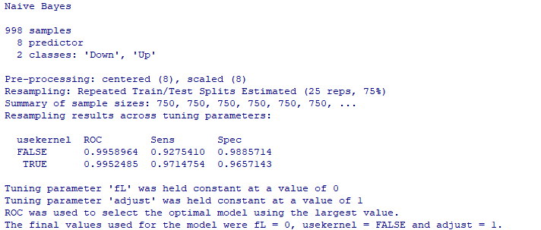
Naïve Bayes output

Slide 30
KNN
###############################K-nearest neighbors############################## set.seed(1) KNNTune <- train(x = as.matrix(Smarket.train[,1:8]), y = Smarket.train$Direction, method = "knn", metric = "ROC", preProc = c("center", "scale"), tuneGrid = data.frame(.k = seq(1,400, by=10)), trControl = ctrl) plot(KNNTune)

Slide 31
KNN output (K = 391)

Slide 32
Neural networks
Chapter 13: Nonlinear Classification Models

Slide 33
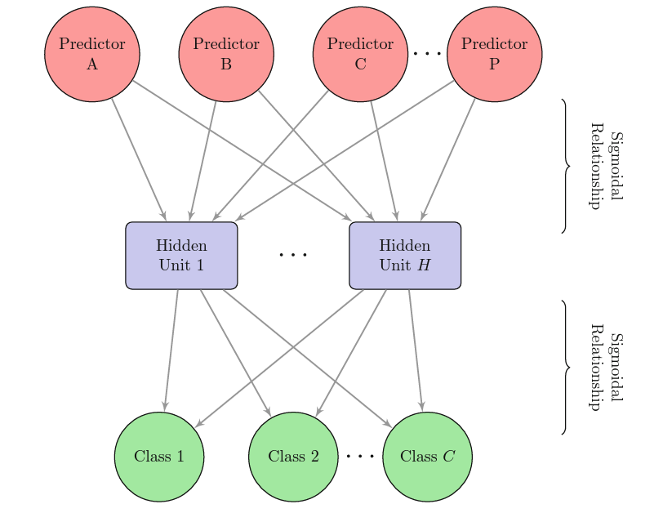
Neural networks

Slide 34
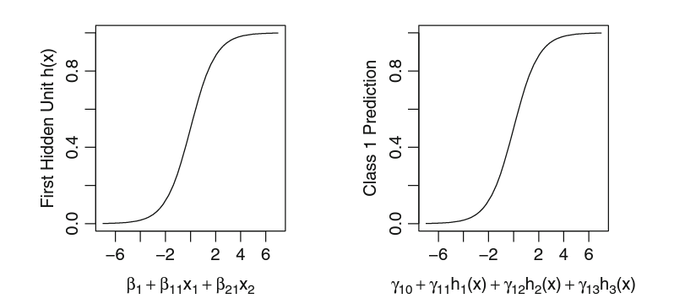
Neural networks
A diagram of a neural network for classification with a single hidden layer.
The hidden units are linear combinations of the predictors that have been transformed by a sigmoidal function.
The output is also modeled by a sigmoidal function

Slide 35
Remarks on neural networks
Like their regression counterparts, neural networks for classification have a significant potential for over-fitting. However, model averaging helps reduce over-fitting.
Collinearity and non-informative predictors will have a comparable impact on model performance.
To increase the effectiveness of neural networks, various transformations of the data were evaluated. One in particular, the spatial sign transformation, had a significant positive impact on the performance of the neural networks for these data.

Slide 36
Neural networks
###############################Neural networks############################ set.seed(476) nnetGrid <- expand.grid(.size = 1:10, .decay = c(0, .1, 1, 2)) maxSize <- max(nnetGrid$.size) numWts <-200 NNTune <- train(x = as.matrix(Smarket.train[,1:8]), y = Smarket.train$Direction, method = "nnet", metric = "ROC", preProc = c("center", "scale", "spatialSign"), tuneGrid = nnetGrid, trace = FALSE, maxit = 2000, MaxNWts = numWts, trControl = ctrl) NNTune plot(NNTune)

Slide 37
Neural networks output

Slide 38
Flexible Discriminant Analysis
Chapter 13: Nonlinear Classification Models

Slide 39
Flexible discriminant analysis (FDA)
FDA allows the idea of linear discriminant analysis to be extended in a number of ways:
Many of the models in Chapters 6 and 7, such as the lasso, ridge regression, or MARS, can be extended to create discriminant variables.
The lasso can create discriminant functions with feature selection.
This conceptual framework is referred to as flexible discriminant analysis (FDA).
If many of the predictors are on different scales, it is difficult for the FDA model to uncover which predictors have the most impact on the response variable (variable importance).

Slide 40
FDA
###############################Flexible discriminant analysis############################### set.seed(476) FDATune <- train(x = as.matrix(Smarket.train[,1:8]), y = Smarket.train$Direction, method = "fda", preProc = c('center', 'scale'), metric = "ROC", trControl = ctrl) FDATune

Slide 41
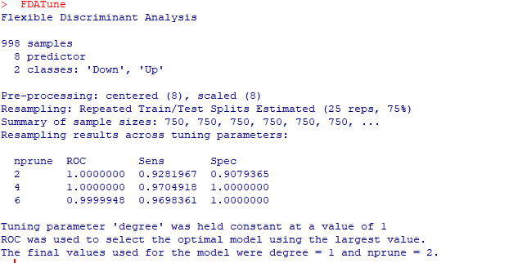
FDA output

Slide 42
Support Vector Machines
Chapter 13: Nonlinear Classification Models

Slide 43
Support vector machines
Support vector machine was developed in the computer science community in the 1990s, and it has been considered one of the best “out of the box” classifiers. Specifically, we will learn
maximal margin classifier
support vector classifier
support vector machine
People often loosely refer to these approaches as “support vector machines.” To avoid confusion, we will carefully distinguish between these three notions.

Slide 44
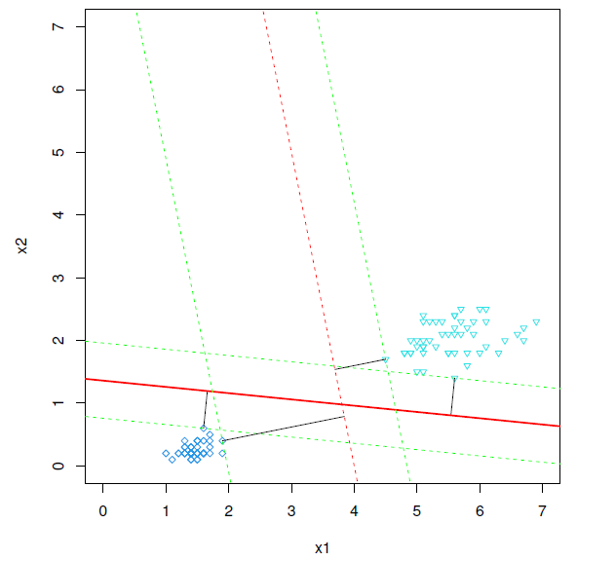
Maximal margin classifier
Among all separating hyperplanes, find the one that makes the biggest gap or margin between the two classes.
The two observations on the dashed lines are known as support vectors, since the maximal margin hyperplane depends directly on them, not one the other observations

Slide 45
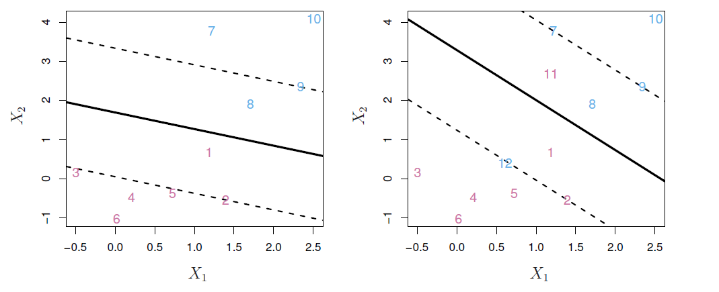
Support vector classifier
The support vector classifier maximizes a soft margin, which tries to separate most of the training observations into the two classes, but may misclassify a few observations.

Slide 46
Remarks
When we don’t allow any samples to be inside the margin, we are talking about the hard margin.
More often, we use soft margin classification, in which we allow certain samples to be inside the margin
By doing so, the overall fit of the model to the data might very well be better than with hard margin classification
It would reduce variance at the cost of some bias (i.e., the bias-variance trade-off)
So, here is where the “Cost” is introduced
Purpose: modify the optimization problem to optimize both the fit of the line to data and penalizing the amount of samples inside the margin at the same time
C defines the weight of how much samples inside the margin contribute to the overall error: the low value of C allows more samples inside the margin; near 0 means every sample can be inside.

Slide 47
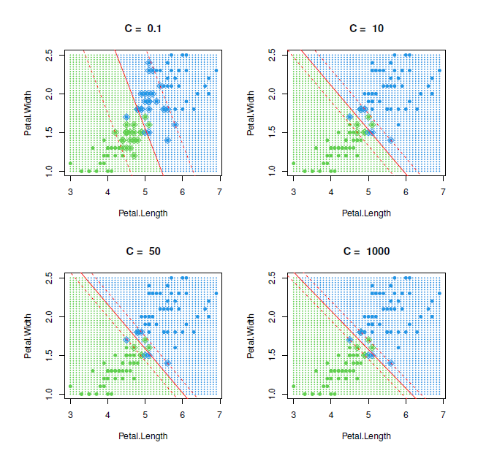
Tuning parameter of cost “C”

Slide 48
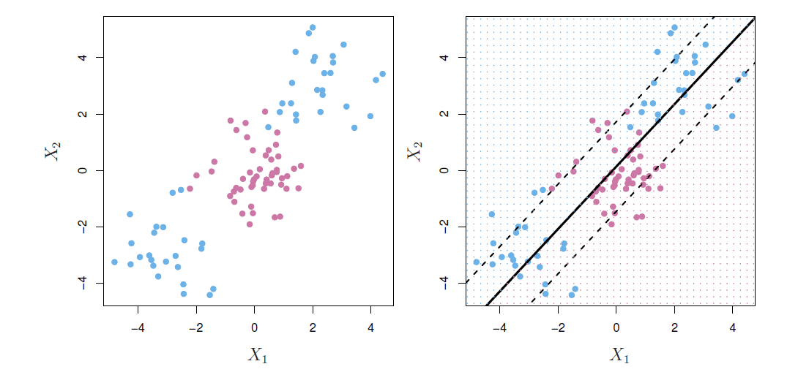
Linear boundary can fail
In practice we are sometimes faced with non-linear class boundaries.
It is clear that a support vector classifier or any linear classifier will perform poorly here.

Slide 49
Support vector machines (SVM)
The maximal classifier and the support vector classifier considered linear classification boundaries.
To extend the linear nature of the model to nonlinear classification boundaries, we consider kernel function instead of the simple linear relationship. There are three popular kernels,
Polynomial
Radial basis function
Hyperbolic tangent
The kernel trick allows the SVM model produce extremely flexible decision boundaries.

Slide 50
Remarks on SVM
The choice of the kernel function parameters and the cost value control the complexity and should be tuned appropriately so that the model does not over-fit the training data.
Using resampling to find appropriate values of tuning parameters tends to find a reasonable balance between under- and over-fitting.
From our experience, SVM models tend to be very competitive for most classification problems.

Slide 51
SVM
###############################Support Vector Machines############################### set.seed(476) sigmaRangeReduced <- sigest(as.matrix(Smarket.train[,1:8])) svmRGridReduced <- expand.grid(.sigma = sigmaRangeReduced[1], .C = 2^(seq(-4, 4))) SVMTune <- train(x = as.matrix(Smarket.train[,1:8]), y = Smarket.train$Direction, method = "svmRadial", #svmLinear #svmPoly metric = "ROC", preProc = c("center", "scale"), tuneGrid = svmRGridReduced, fit = FALSE, trControl = ctrl) SVMTune

Slide 52
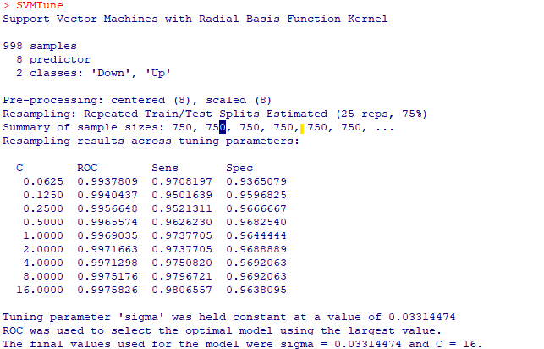
SVM output

Slide 53
Model comparison with ROC and Confusion Matrix
Chapter 13: Nonlinear Classification Models

Slide 54
Prediction based on different models
### Predict the test set based on eight models #QDA Smarket.test$QDA<- predict(QDATune,Smarket.test, type = "prob")[,1] #RDA Smarket.test$RDA <- predict(RDATune,Smarket.test, type = "prob")[,1] #MDA Smarket.test$MDA <- predict(MDATune,Smarket.test, type = "prob")[,1] #NB Smarket.test$NB <- predict(NBTune,Smarket.test, type = "prob")[,1] #KNN Smarket.test$KNN <- predict(KNNTune,Smarket.test, type = "prob")[,1] #NN Smarket.test$NN <- predict(NNTune,Smarket.test, type = "prob")[,1] #FDA Smarket.test$FDA <- predict(FDATune, Smarket.test, type = "prob")[,1] #SVM Smarket.test$SVM <- predict(SVMTune, Smarket.test[,1:8], type = "prob")[,1]

Slide 55
ROCs based on different models
#ROC for QDA QDAROC <- roc(Smarket.test$Direction, Smarket.test$QDA) plot(QDAROC, col=1, lty=1, lwd=2) #ROC for RDA RDAROC <- roc(Smarket.test$Direction, Smarket.test$RDA) lines(RDAROC, col=2, lty=2, lwd=2) #ROC for MDA MDAROC <- roc(Smarket.test$Direction, Smarket.test$MDA) lines(MDAROC, col=3, lty=3, lwd=2) #ROC for NB NBROC <- roc(Smarket.test$Direction, Smarket.test$NB) lines(NBROC, col=4, lty=4, lwd=2)

Slide 56
ROCs based on different models
#ROC for KNN KNNROC <- roc(Smarket.test$Direction, Smarket.test$KNN) lines(KNNROC, col=5, lty=5, lwd=2) #ROC for NN NNROC <- roc(Smarket.test$Direction, Smarket.test$NN) lines(NNROC, col=6, lty=6, lwd=2) #ROC for FDA FDAROC <- roc(Smarket.test$Direction, Smarket.test$FDA) lines(FDAROC, col=7, lty=7, lwd=2) #ROC for SVM SVMROC <- roc(Smarket.test$Direction, Smarket.test$SVM) lines(SVMROC, col=8, lty=8, lwd=2) legend('bottomright', c('QDA','RDA','MDA','NV', 'KNN', 'NN', 'FDA','SVM'), col=1:8, lty=1:8,lwd=2)

Slide 57
ROCs based on different models

Slide 58
Confusion matrices of different models
#Confusion matrix of QDA confusionMatrix(data = predict(QDATune, Smarket.test), reference = Smarket.test$Direction) #Confusion Matrix of RDA confusionMatrix(data = predict(RDATune, Smarket.test), reference = Smarket.test$Direction) #Confusion matrix of MDA confusionMatrix(data = predict(MDATune, Smarket.test), reference = Smarket.test$Direction) #Confusion matrix of NB confusionMatrix(data = predict(NBTune, Smarket.test), reference = Smarket.test$Direction)

Slide 59
Confusion matrices of different models
#Confusion matrix of KNN confusionMatrix(data = predict(KNNTune, Smarket.test), reference = Smarket.test$Direction) #Confusion matrix of NN confusionMatrix(data = predict(NNTune, Smarket.test), reference = Smarket.test$Direction) #Confusion matrix of FDA confusionMatrix(data = predict(FDATune, Smarket.test), reference = Smarket.test$Direction) #Confusion matrix of SVM confusionMatrix(data = predict(SVMTune, Smarket.test[,1:8]), reference = Smarket.test$Direction)

Slide 60
Summary of output
Model | Accuracy | Kappa | Sensitivity | Specificity
QDA | 0.9127 | 0.8232 | 0.9099 | 0.9149
RDA | 0.9524 | 0.9025 | 0.9009 | 0.9929
MDA | 0.9683 | 0.9353 | 0. 9459 | 0.9858
NB | 0.9444 | 0.8873 | 0.9369 | 0.9504
KNN | 0.7460 | 0.4511 | 0.4234 | 1.0000
NN | 0.9960 | 0.9920 | 1.0000 | 0.9929
FDA | 0.9365 | 0.8692 | 0.8559 | 1.0000
SVM | 0.9365 | 0.8709 | 0.9189 | 0.9504
Logistic | 0.9960 | 0.9919 | 0.9910 | 1.0000
LDA | 0.9524 | 0.9025 | 0.9009 | 0.9929
PLSDA | 0.9405 | 0.8775 | 0.8649 | 1.0000
Penalized model | 0.9841 | 0.9677 | 0.9640 | 1.0000
NSC | 0.9524 | 0.9023 | 0.8919 | 1.0000

Slide 61
Model comparisons based on resamples of Training data
#Resamples of Tranining data res = resamples(list(QDA = QDATune, RDA =RDATune,MDA = MDATune, NB = NBTune, KNN = KNNTune, NN = NNTune, FDA = FDATune, SVM = SVMTune )) dotplot(res) #We can add the models from chapter 12 res1 = resamples(list(Logistic = logisticTune, LDA =ldaTune,PLSDA = plsdaTune, Penalized = glmnTune, NSC = nscTune,QDA = QDATune, RDA =RDATune,MDA = MDATune, NB = NBTune, KNN = KNNTune, NN = NNTune, FDA = FDATune, SVM = SVMTune )) dotplot(res1)

Slide 62
Models from Chapter 13

Slide 63
Models from Chapters 12 and 13

